Slide 1

SCENARIOS WHERE AUTOMATION PREVENTS ERROR

Slide 2
SCENARIO :4 File Search Manager HOW TO FILE SEARCH MANAGER THAT ALLOWS TO FIND/FILTER FILES USING TIMESTAMP , NAME , PERMISSIONS , FILE OWNERSHIP , SIZE etc.

Slide 3
WHAT IS THE ERROR?
STARTING FROM CONFIGURING WEB SERVER TO DEPLOYING A COMPLEX APPLICATION, THERE WILL BE THOUSANDS OF FILES INVOLVED AND IT IS VERY DIFFICULT TO LOCATE THEM EXACTLY UNLESS WE HAVE A UTILITY TO HELP. PERFORMING THIS TASK MANUALLY IS A COMPLICATED AND AS WELL AS TIME CONSUMING TASK.

Slide 4
FIND UTILITY : HELPS US TO FILTER THE FILES BASED ON THE CRITERIA WE GIVE.
GET THE DIRECTORY TO SEARCH FOR FILES FROM THE ARGUMENT AND THE NAME , TIMESTAMP ,SIZE , OWNER AND PERMISSIONS OF THE FILES AS INPUTS.
BASED ON THE GIVEN ARGUMENTS CONSTRUCT THE FILTER OPTIONS THAT WILL BE PASSED TO FIND AS ARGUMNETS.
ONCE THE FILTRER OPTIONS ARE CREATED , RUN THE COMMAND AND SHOW THE LIST OF MATCHED FILES THAT ARE RETURNED BY THE “FIND’’ UTILITY
IF THE FIND UTILITY IS NOT ABLE TO FIND ANY MATCHES , IT RETURNS WITH A NON-ZERO EXIT CODE.

Slide 5



USING FIND UTILTY
Finding files using name in current directory.
# find . –name tecmint.txt
Find files under home directory.
#find /home –name tecmint.txt
Find files using name and ignoring case .
#find /home –iname tecmint.txt

Slide 6
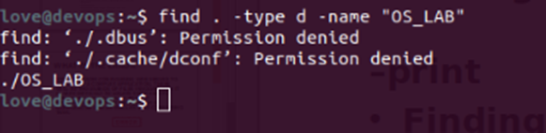

Find directories using name.
# find /-type d –name tecmint
Finding files using 777 permissions
# find . –type f –perm 0777
Finding files without 777 permissions
# find / -type f | -perm 777
Find readonly files
# find / -perm /u=r
Find executable files
# find / -perm /a=x

Slide 7
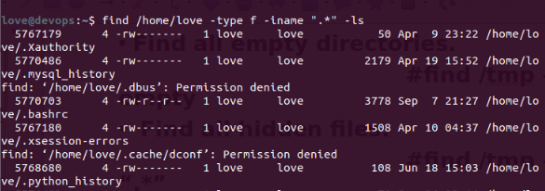
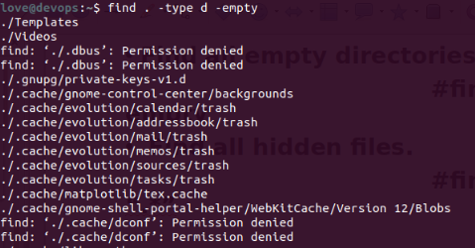
Find all empty directories.
# find /tmp –type d –empty
Find all hidden files.
# find /tmp –type f –name “.*”

Slide 8
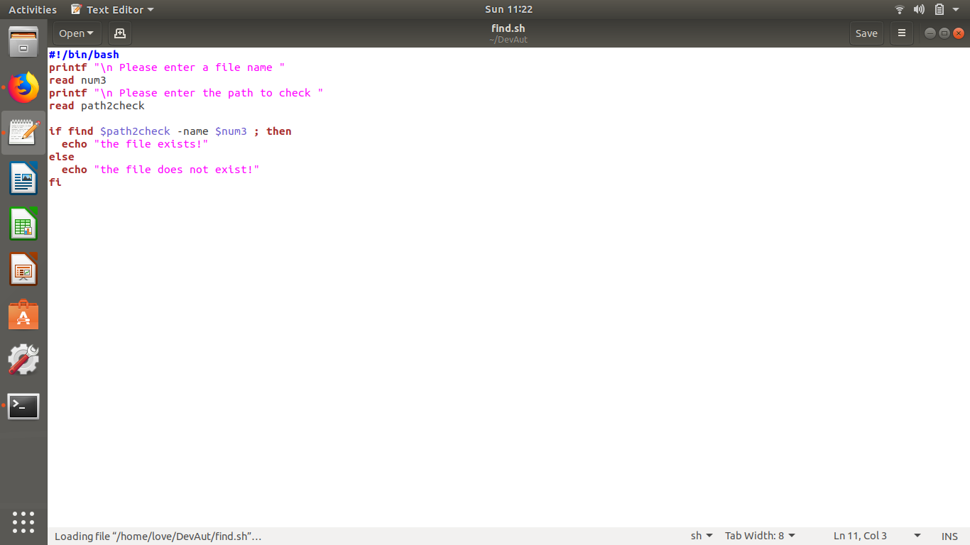
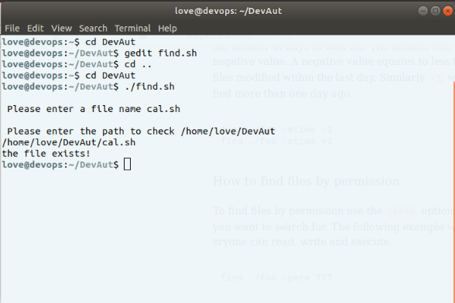

Slide 9
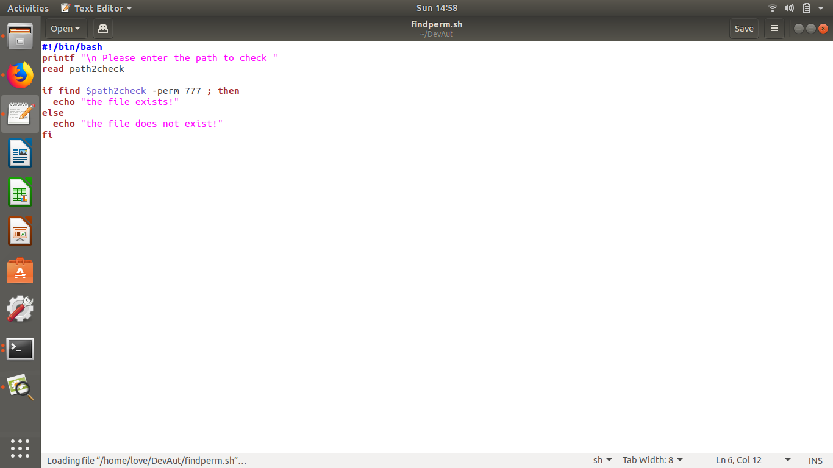
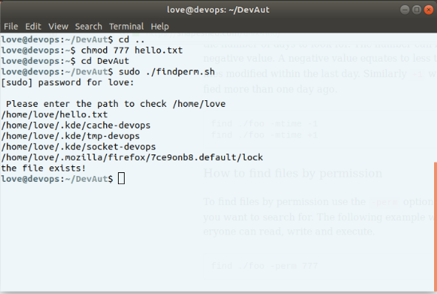

Slide 10
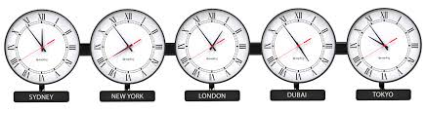
Scenario 5 : timezone helper
I NEED TO SHOW THE CURRENT TIME IN THE SPECIFIED TIMEZONE

Slide 11
How it causes error.
A TIME ZONE IS A REGION THAT OBSERVES A UNIFORM STANDARD TIME FOR LEGAL , COMMERCIAL , AND OTHER SOCIAL PURPOSES.
WHILE WORKING WITH THE REMOTE TEAM THE MAJOR CHALLENGE THAT COMES UNDER LIGHT IS DIFFERENT TIME ZONES.
AND WHILE WORKING IN NON_REMOTE TEAM FOR SCHEDULING A JOB CRON-TAB TOOL IS USED WHICH HELPS IN SCHEDULING JOBS.

Slide 12
HOW IS IT SOLVED?
SET THE LINUX DIRECTORY CONTAINING THE LIST OF FILES FOR ALL THE TIME ZONES.
IF THE TIME ZONE DIRECTORY IS NOT FOUND AT THE GIVEN LOCATION , THROW AN ERROR SAYING THE DIRECTORY DOESN’T EXIST AND EXIT THE PROGRAM.
IF NO ARGUMENTS ARE GIVEN , SHOW THE DATE TIME , IN THE UTC FORMAT AND EXIT.

Slide 13
IF FIRST ARGUMENT IS THE LIST THEN SHOW THE LIST OF TIMEZONES AVAILABLE ON THE SYSTEM.
FOR ARGUMENT OTHER THAN THE LIST TAKE ITS AS NAME OF THE TIME ZONE AND SHOW THE DATE AND THE TIME IF TIMEZONE EXISTS.
IF THE GIVEN TIME ZONE IS NOT FOUND , THROW AN ERROR AND THIS IS AUTOMATICALLY DONE BY DATE FUNCTION..

Slide 14
WHEN WORKING IN REMOTE TEAM:
TASK SCHEDULING WHEN WORKING IN A REMOTE TEAM BECOMES QUITE DIFFICULT BECAUSE OF DIFFERENT TIME ZONES.
IT IS NECESSARY TO MAINTAIN AUTOMATION TIME SERVER SO THAT WHOLE TEAM CAN REMAIN IN SYNC.

Slide 15
EXAMPLE:
MEDICINE REMINDER APP.
Suppose : If someone needs to take their medicines at 9:00 AM everyday then they need to take it at that time in the timezone they are in. A CEO who took her vitamins at 9:00 AM when she was in New York would need to take them at 9:00 AM in Paris if she happened to be there the next day. The time for the event itself is saved without any timezone data, but the scheduler itself needs to be aware of the applicable timezone which is usually to be done manually by the user unless the device is capable of automatically switching timezones (either from GPS data, or the mobile signal).

Slide 16
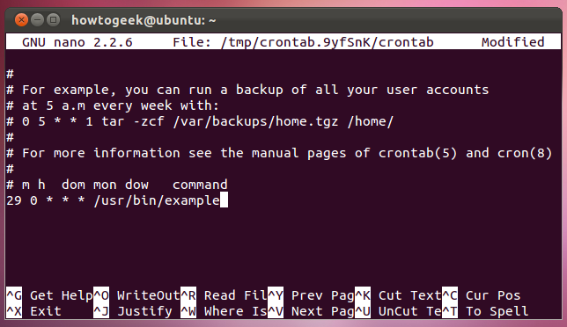
CRONTAB (TASK SCHEDULAR)
The cron daemon is a long-running process that executes commands at specific dates and times. You can use this to schedule activities, either as

Slide 17
Commands are executed by cron when the minute, hour, and month of year fields match the current time, and when at least one of the two day fields (day of month, or day of week) match the current time. A field may be an asterisk (*), which always stands for "first-last". m = minute h = hour dom= day of month mon=month of year dow=day of weak

Slide 18
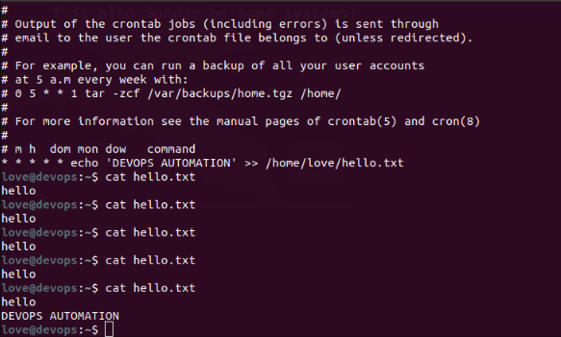
Providing (*) in every column would bring change to the file every minute

Slide 19
USING ANACRON
Anacron differs with cron in the way it schedules task. Cron assumes that system would be running continuously i.e if system shuts down and cron has to run a scheduled task , it would be skipped and will not be executed.
But in case of Anacron if system is off during some scheduled task execution , Anacron would make that task run as soon as system is up.
Minimum granularity with Cron is minute while it is in days with Anacron

Slide 20
SCENARIO 6 : FETCH LATEST / OLDEST FILES
HOW TO SHOW THE 10 LATEST / OLDEST MODIFIED FILES IN THE GIVEN DIRECTION?

Slide 21
WHAT IF DONE MANUALLY?
AS SAID IN SENARIO 4 , CONFIGURING A WEB SERVER TO DEPLOYING A COMPLEX APPLICATION , THERE WILL BE THOUSAND OF FILES INVOLVED AND IT IS VERY DIFFICULT TO TRAVERSE THROUGH ALL OF THEM LOOKING FOR SOME SPECIFIC DETAIL.

Slide 22
PSUEDO CODE FOR FETCHING LATEST/OLDEST FILES
INTIALLY SPECIFY THE MAXIMUM NUMBER OF FILES TO DISPLAY WHICH CAN BE OVERWRITTEN WITH THE USER’S VALUE FROM ARGUMENTS IF ANY.
BY LOOPING THROUGH GIVEN ARGUMENTS TO MAP THE OPTIONS WITH THEIR APPROPRIATE FUNCTIONALITIES. FOR EXAMPLE RECURSIVELY INCLUDING FILES , HIDDEN FILES etc.. .
THE ‘FIND’ UTILITY WILL BE USED WITH THE CONSTRUCTED QUERY FILTERS FROM THE OPTIONS TO FETCH THE REQUIRED FILES..
ONCE THE FILE IS GENERATED , MORE DETAILS CAN BE ACQUIRED USING LS COMMAND

Slide 23
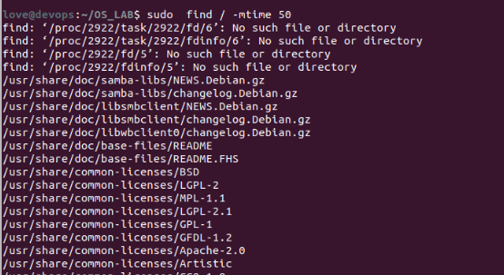
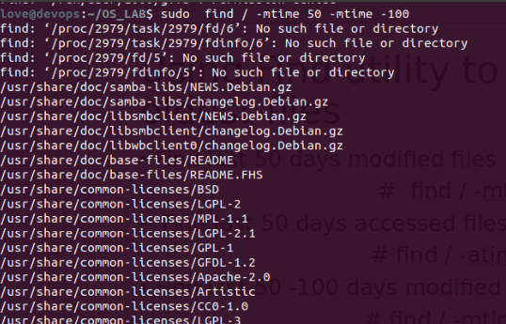
Using Find utility to fetch latest and oldest files
Find last 50 days modified files
# find / -mtime 50
Find last 50 days accessed files.
# find / -atime 50
Find last 50 -100 days modified files
# find / -mtime +50 –mtime -100

Slide 24
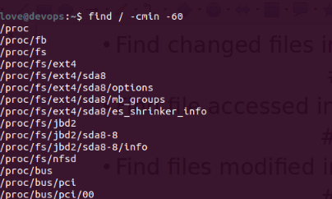
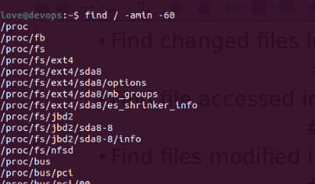
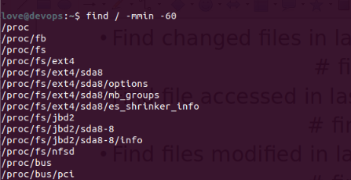
Find changed files in last 1 hour
# find / -cmin -60
Find file accessed in last 1 hour
# find / -amin -60
Find files modified in last 1 hour
# find / -mmin -60

